Slide 1

Micro-Credit Defaulter Project
Guided By:
Srishti Maan
Presented By:
Prerna Jain

Slide 2
ABSTRACT
A Microfinance Institution (MFI) is an organization that offers financial services to low-income populations. MFS becomes very useful when targeting especially the unbanked poor families living in remote areas with not much sources of income.
The Microfinance services (MFS) provided by MFI are Group Loans, Agricultural Loans, Individual Business Loans and so on.
Many microfinance institutions (MFI), experts and donors are supporting the idea of using mobile financial services (MFS) which they feel are more convenient and efficient, and cost saving, than the traditional high-touch model used since long for the purpose of delivering microfinance services.
The MFI industry is primarily focusing on low-income families and is very useful in such areas, the implementation of MFS has been uneven with both significant challenges and successes.

Slide 3
INTRODUCTION
Build a model which can be used to predict in terms of a probability for each loan transaction, whether the customer will be paying back the loaned amount within 5 days of insurance of loan or not.
In this case, Label ‘1’ indicates that the loan has been paid that is Non- defaulter, while, Label ‘0’ indicates that the loan has not been paid that is defaulter.

Slide 4
EXPERIMENTAL SET UP
Hardware requirements:-
1. Processor — core i5 and above
2. RAM — 8 GB or above
3. SSD— 250 GB or above
Software requirements:-
1. ANACONDA

Slide 5
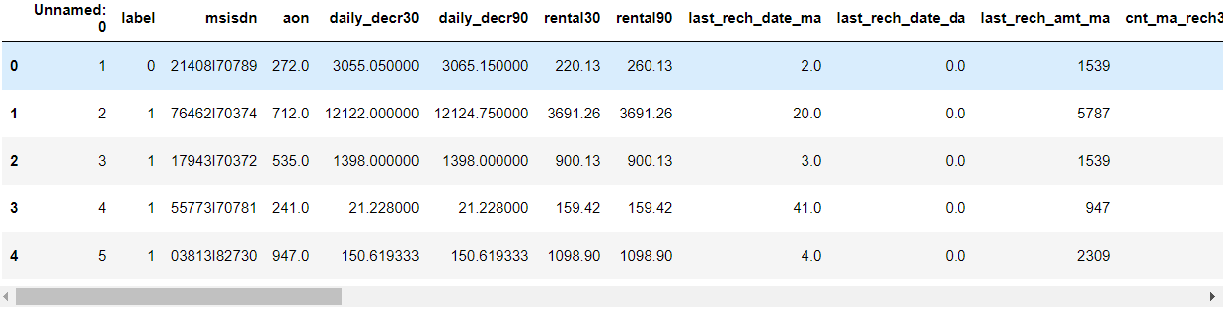
DATA PREPRATION
With the help of Pandas Library We will upload our data to Jupyter Notebook.
Once our data is uploaded with the help of predefined method (i.e. read_csv) we can read data for further processing.
We have two type of variables in the data:-
Dependent Variable
Independent Variable

Slide 6
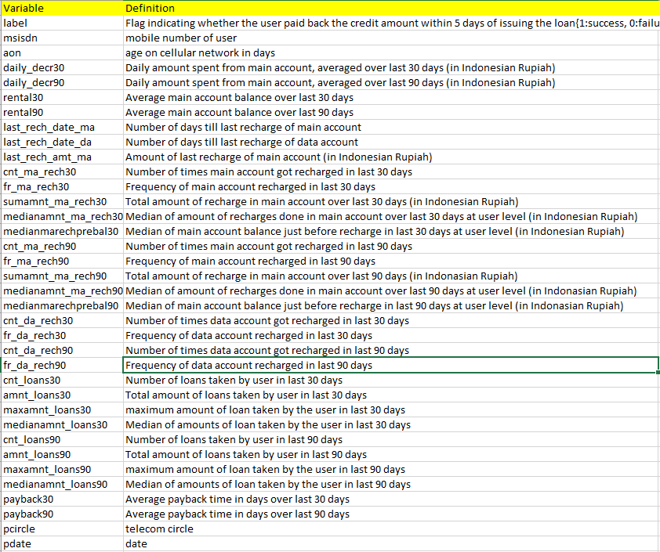
Label is an independent variable where as all of the other element are dependent variable.

Slide 7
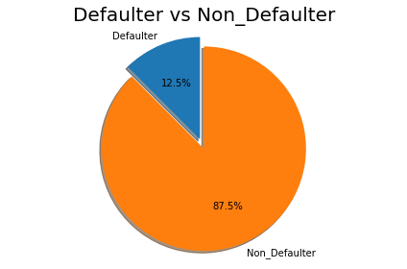
Total records = 209593
Defaulter = 26162
Non_Defaulter = 183431
This picture tells us 12.5% people are Defaulter where as 87.5% people are not defaulter.

Slide 8
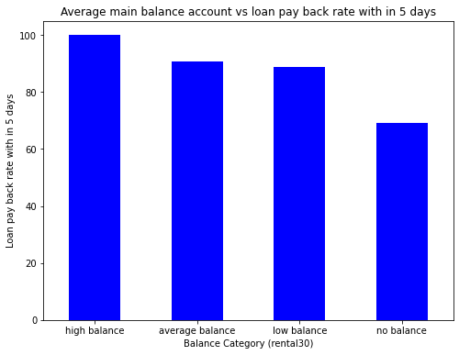
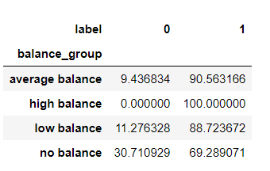
Balance_group is created by us, just to showcase and understand the Average main balance of account and loan pay back rate in 5 days relationship.
The customer who have high balance that customer is able to pay is loan in 5 days.
The customer who has average balance and low balance in that 10-12% people does not pay loan within 5 days.
The customer who is having low balance that more than 30% customer are not paying loan within 5 days.

Slide 9
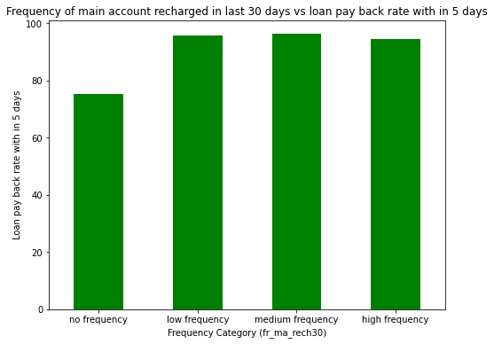
Frequency_group column is created by us, just to showcase the Frequency of main account recharged in last 30 days and loan pay back rate relationship.
no frequency 75.129316
low frequency 95.695127
medium frequency 96.212001
high frequency 94.518960
Customer who has low frequency of main account recharged in last 30 days in that almost 25% customers are not paying loan within 5 days.
Customer who has low, medium and high frequency of main account recharged in last 30 days in that almost 45-5.5% people are not paying loan within 5 days.

Slide 10
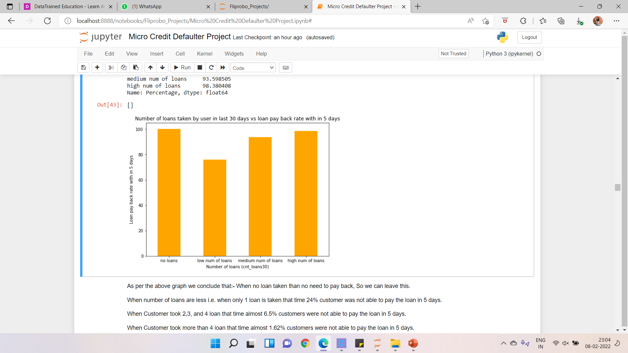
Loan_frequency_group is created by us, just to showcase and see the relationship between Number of loans taken by user in last 30 days vs loan pay back with in 5 days.
no loans 100.000000
low num of loans 76.027184
medium num of loans 93.598505
high num of loans 98.380408
When no loan taken than no need to pay back, so we can leave this.
When number of loans are less i.e., when only 1 loan is taken that time 24% customer was not able to pay the loan in 5 days.
When Customer took 2,3, and 4 loan that time almost 6.5% customers were not able to pay the loan in 5 days.
When Customer took more than 4 loan that time almost 1.62% customers were not able to pay the loan in 5 days.

Slide 11
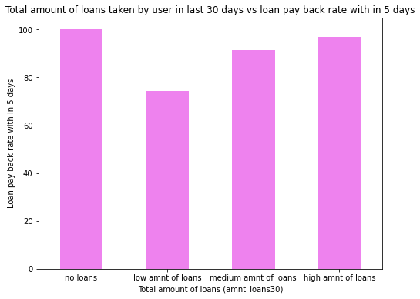
Loan amnt_frequency_group is created by us, just to showcase the difference between total amount of loan taken by customer in last 30 days vs loan pay back rate in 5 days.
no loans 100.000000
low amnt of loans 74.347429
medium amnt of loans 91.454128
high amnt of loans 96.819407
When no loan taken than no need to pay back, so we can leave this.
When amount of loan is less i.e., between 1-6 that time 26% customer was not able to pay the loan in 5 days.
When amount of loan is medium i.e., between 7-12 that time almost 8.5% customers were not able to pay the loan in 5 days.
When amount of loan is high i.e., more than 12 that time almost 3.2% customers were not able to pay the loan in 5 days.

Slide 12
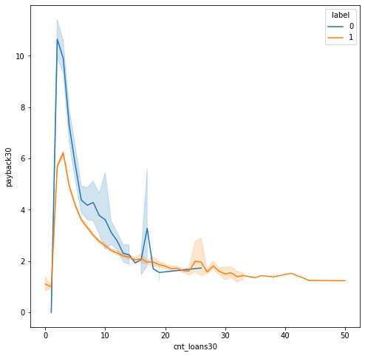
Number of loans taken by Customer in last 30 days and payback of loan in 30 days over label
If customer took more than 25 loan than in that case, he/she replayed the loan on time always.
When customer took approx. 2-4 loan that time, he/she didn't pay the loan back on time.

Slide 13
DATA PREPROCESSING
The Complete data is divided in the ration of 70:30 for train and test respectively.
There is no null value in the dataset but there are some outliers present in the dataset which has been removed with the help of medium of the columns and Z score.
Once our data is ready categorical variables are converted into the numeric form, which we can apply further on algorithms.
I have dropped the Unnamed: 0, msisdn, pcircle, pdate, last_rech_date_ma, cnt_ma_rech30, fr_ma_rech30, cnt_da_rech30, fr_da_rech30, cnt_da_rech90, fr_da_rech90, maxamnt_loans30, medianamnt_loans30, medianamnt_loans90 column since there is no correlation between output variable(Label) and with these columns.

Slide 14
EVALUTION PROCESS
Evaluation Matrices:
Accuracy - it determines how often a model predicts default and non default correctly.
Precision-it calculates whenever our models predicts it is default how often it is correct.
Recall- Recall regulate the actual default that the model is actually predict.
Precision Recall Curve - PRC will display the tradeoff between Precision and Recall threshold.
Cross Validations:
K Fold cross validations , K = 5

Slide 15
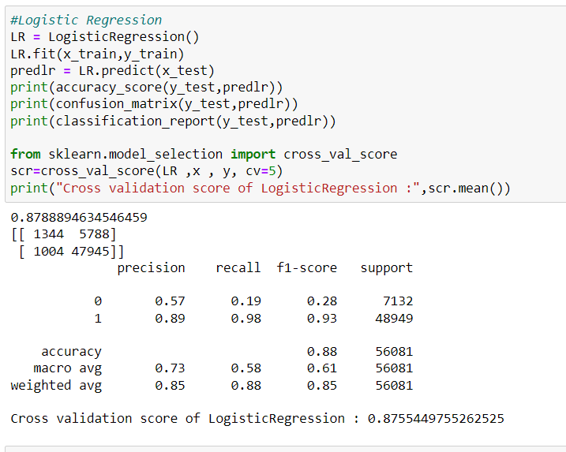
Logistic Regression

Slide 16
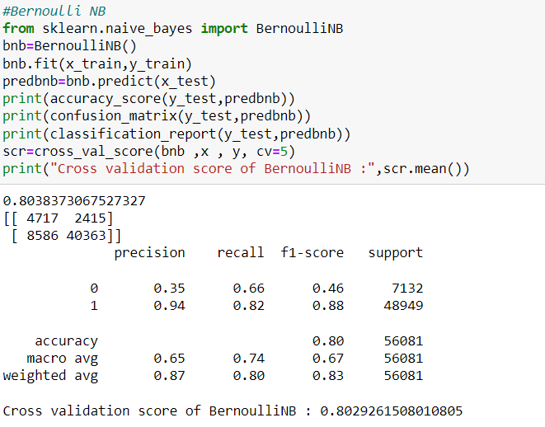
Bernoulli NB

Slide 17
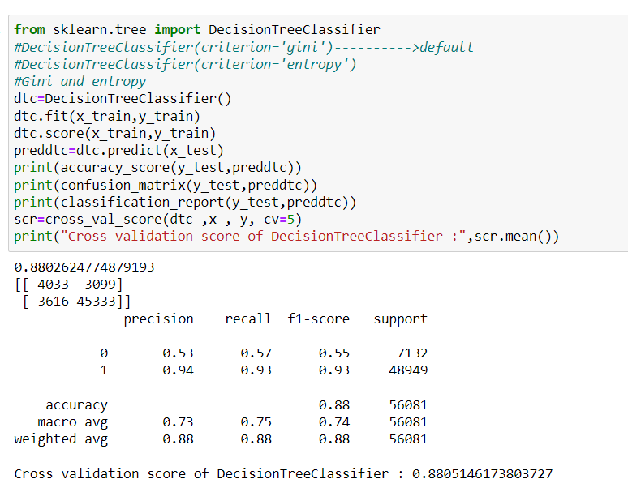
Decision Tree Classifier

Slide 18
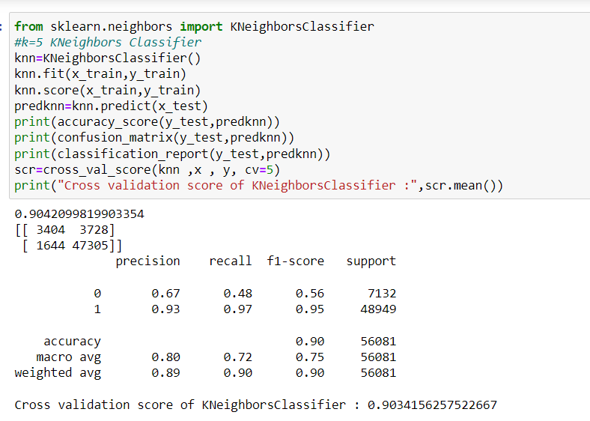
K Neighbors Classifier

Slide 19
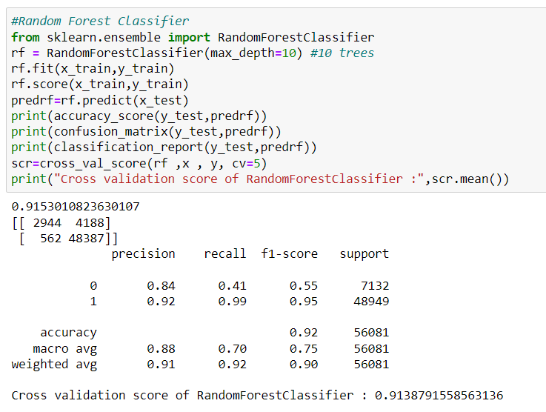
Random Forest Classifier

Slide 20
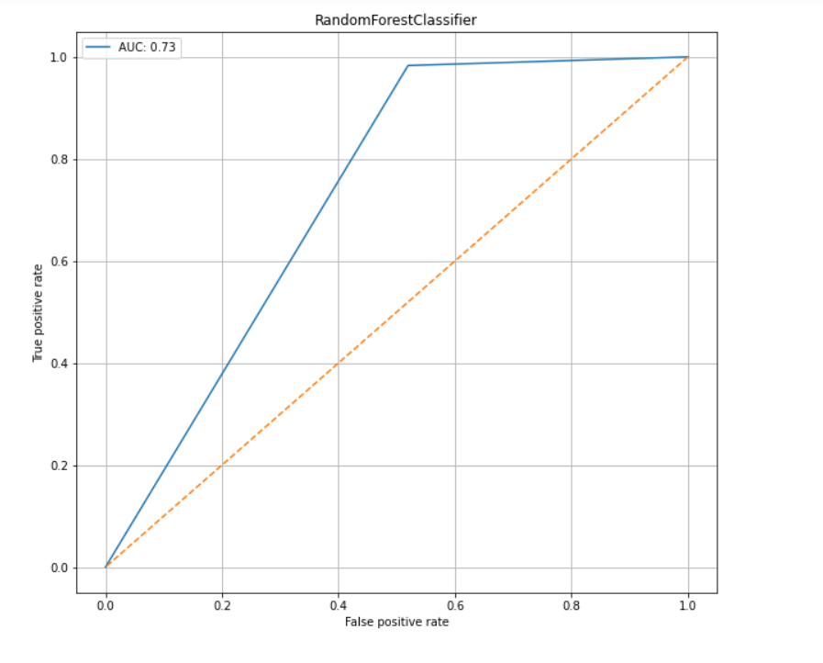
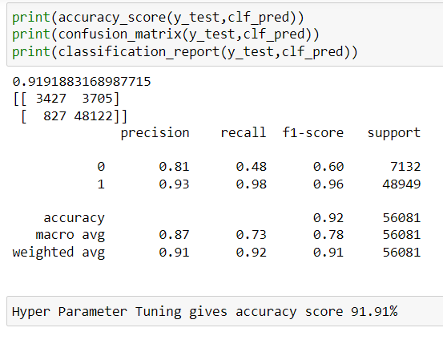
RESULT
From the details on the above solutions it is clearly understandable that we are getting best result with the help of Random Forest Classifier so we save this model with the help of joblib Library.

Slide 21
CONCLUSION
From this dataset I get to know that each feature plays a very import role to understand the data. Data format plays a very important role in the visualization and Appling the models and algorithms.
The power of visualization is helpful for the understanding of data into the graphical representation its help me to understand that what data is trying to say, Data cleaning is one of the most important steps to remove missing value or null value fill it by mean median or by mode or by 0.
Various algorithms I used in this dataset and to get out best result and save that model. The best algorithm is Random Forest Classifier.

Slide 22
FUTURE WORK
Limitations of this project is, it has lots of outliers. If we try to fix outliers by some technique the accuracy goes down. If we dop the outliers than we are losing more than 20% of the data.
In future, if someone do the proper and detail study of this dataset’s each column than we will not loss much amount of data and the accuracy will be so high.

Slide 23
Thank you !!!

